Slide 1

Project Topic:- MX Player
Student Members:-
Abhishek Shinde (20104007)
Aniruddha Sawant (20104011)
Dhananjay Phalke (20104120)
Aryan Sankholkar (20104010)
Project Guide:-
Prof. Ganesh Gourshete

Slide 2
Contents
Introduction
Objectives
Scope
Features /Functionality
Project Outcomes
Technology Stack

Slide 3



In an era where the most of the population has succumbed to a work-from-home culture and virtual education because of a worldwide pandemic, music has proved to be a pleasurable escape for a lot of people.
Be it stress from societal pressures, or the continued struggle to adjust to the new normal trends, music has been a constant for so many people looking to find some normalcy in their upturned life.
In this project, we have attempted to create one such platform, where users can easily get access to their favorite songs and stream or download them without the disturbances of ads.

Slide 4

The objectives of this project are summarised below:
To design and develop an easy to use Music Player interface.
To enable users to make use of the interface to download, stream music, create playlists and more.
Creating access to a modest interface for music loving users.

Slide 5

In the current market, even though there may be numerous music streaming platforms available to choose from, users find it difficult to find an Ad-Free platform.
Our music player provides an Ad-Free platform for users to stream music un-interruptedly.
Allows the user to download, create customized playlists and stream music online.

Slide 6
Feature 1 : Create/Delete Playlists
Users can add or delete their favourite songs from playlists and listen to them whenever the users wants to.
Feature 2 : Download Songs
User can download songs and listen to them offline anywhere.
Feature 3 : Favourites
User can add their desired songs to favourite.
Feature 4 : Forward/Backward Songs
Users can play, pause and select songs with last button and next button

Slide 7

The final outcome of the project is as follows:
Users can create their own customized profile with access to their favorite downloaded songs and playlists.
Members are able to create their favourite playlists
Users login details are being stored in the database with respective timestamps.

Slide 8


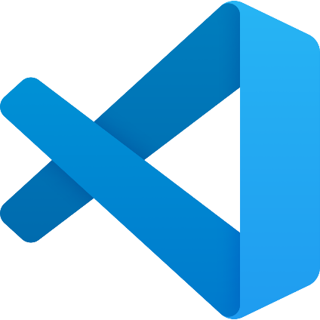

Language used: Python
Editor: Visual Studio Code
Backend: SQL Lite

Slide 9
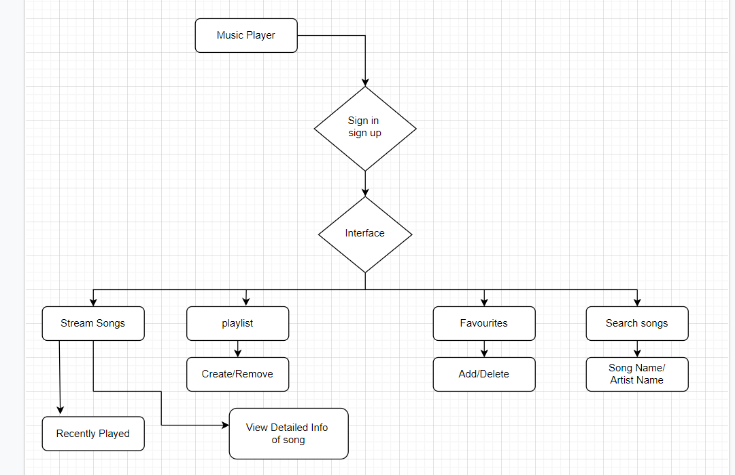
7.Flow Chart:-

Slide 10
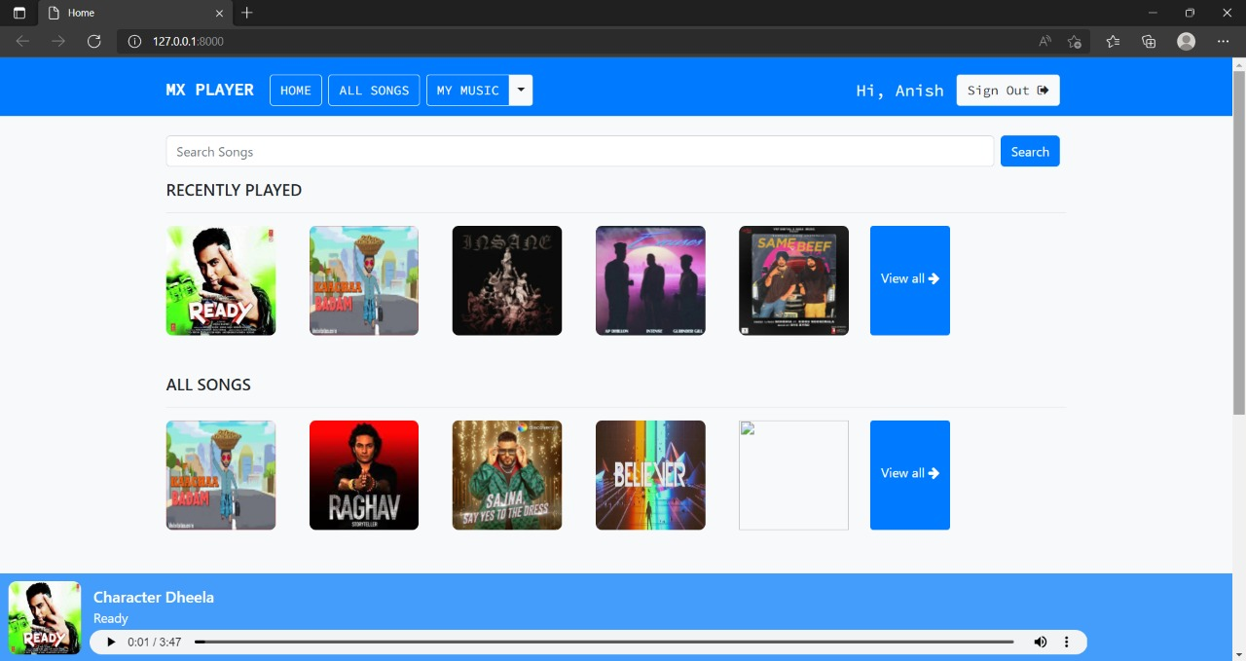
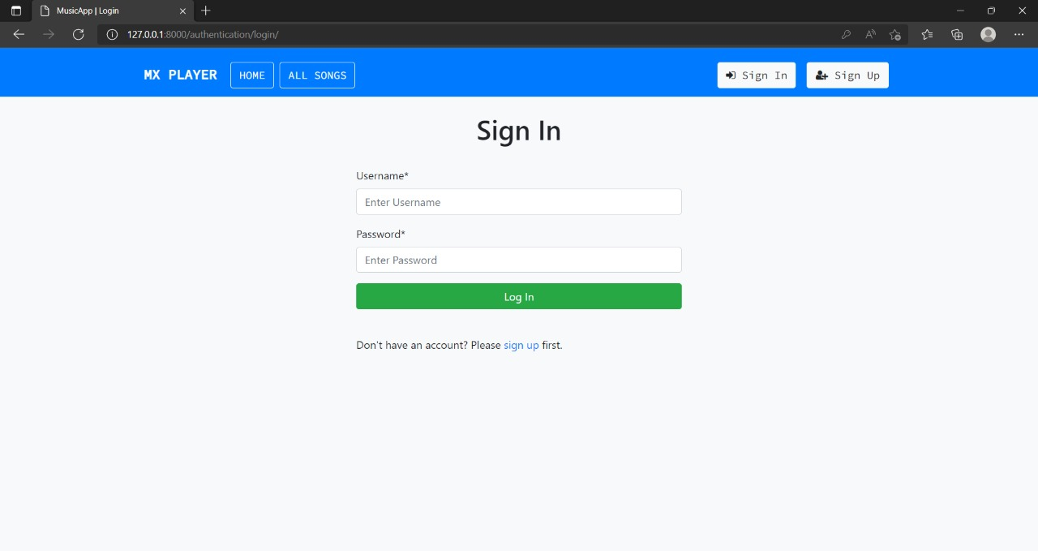
Main Interface
Sign In Page

Slide 11
Conclusion
This project was made with a view to provide an easy to use and relaxed platform which would enable its users to take advantage of its features of making available a huge database of music and songs on demand.
Targeted towards an audience which mainly consists of Gen-Zs and Millennials who are more and more attracted towards uncomplicated and simple platforms for entertainment, we have attempted to create through this project one such digital plot.

Slide 12
Thank You...!!

